Slide 1



Tennis Court Booking
Introduction
Our tennis court booking website is meticulously crafted to simplify the process of reserving tennis courts for players, coaches, and sports enthusiasts alike. The project aims to bridge the gap between the demand for quality tennis courts and the ease of access, offering a streamlined solution for booking courts in various locations. This website project is built with a user-friendly interface, ensuring that both beginners and experienced players can quickly find and book courts that match their preferences be it for practice sessions, matches, or coaching.

Slide 2


Organization Name : Perfetto Solutions
Perfetto Solutions is a full-service software development and Mobile App company based in India. Our range of services include Mobile Apps development and Web Development.

Slide 3
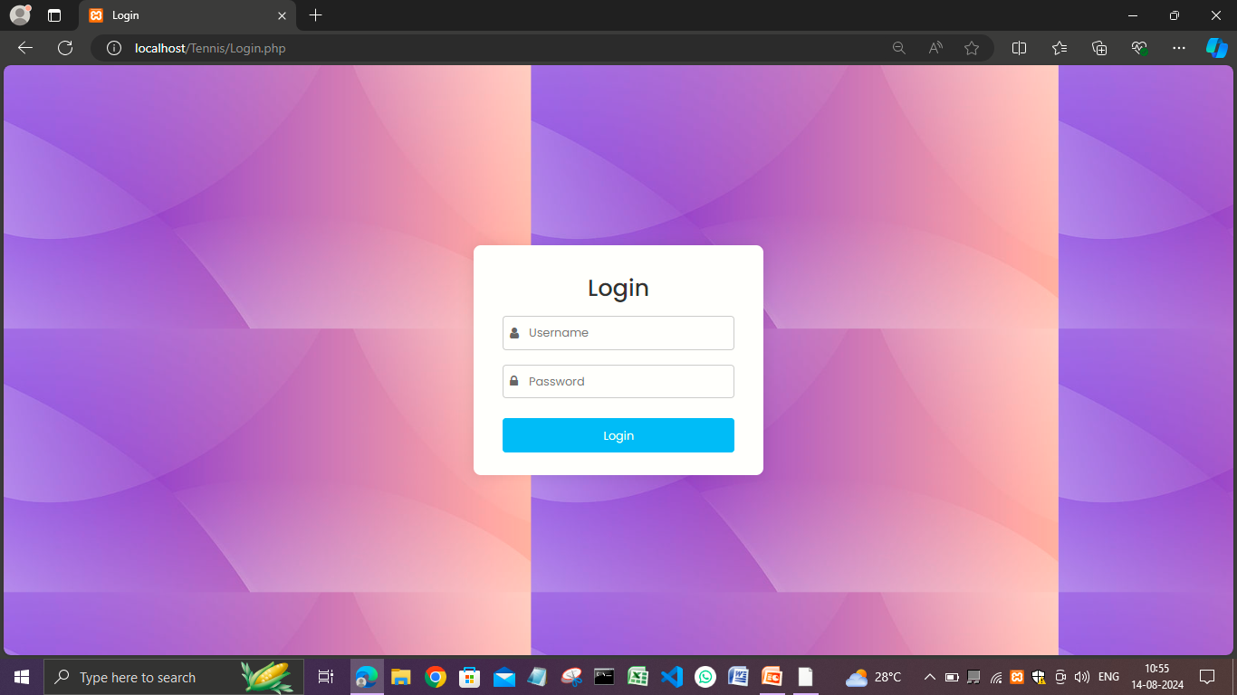
User Login
Welcome to the Tennis Court Booking system. Please log in with your username or email and password to access your account, manage your bookings, and enjoy seamless scheduling of your tennis sessions.

Slide 4
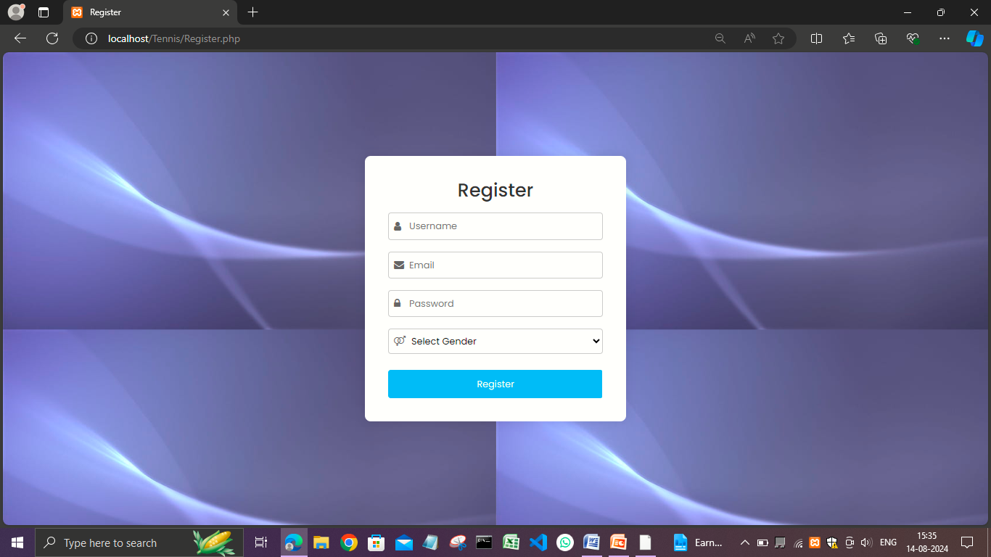
User Registration
Join our platform by completing the simple registration process, providing the necessary details to create your personalized tennis court booking account.

Slide 5
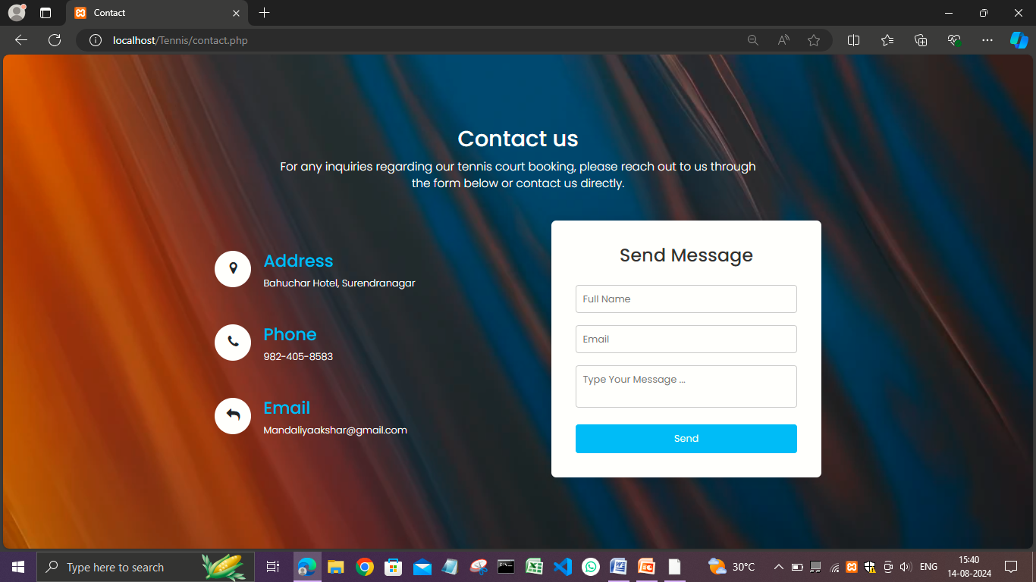



Contact Us
For any inquiries, assistance with bookings, or feedback, please don’t hesitate to reach out to us. You can contact our support team via email at support@tenniscourtbooking.com or call us at +1-234-567-890. Our team is available from Monday to Friday, 9 AM to 6 PM, to help ensure you have the best experience with our tennis court booking system. We look forward to hearing from you!
Email :- MandaliyaAkshar@gmail.com
Phone :- 1234567890
Social Media :- @tenniscourtbooking

Slide 6






Types of Courts
Clay Courts
Hard Courts
Grass Courts
Smooth, red-colored surface providing a slower game.
Durable, all-weather courts with a faster pace.
Lush, green surface requiring more precise footwork.
Coaches

Slide 7
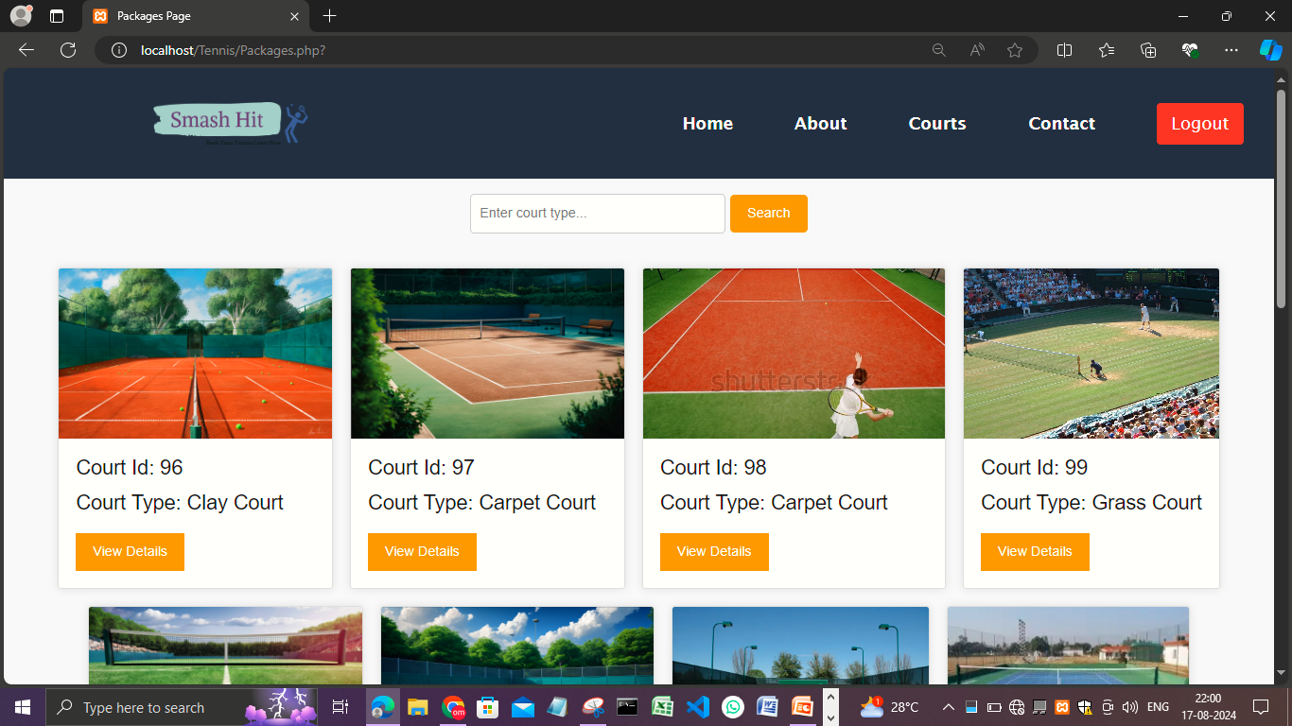
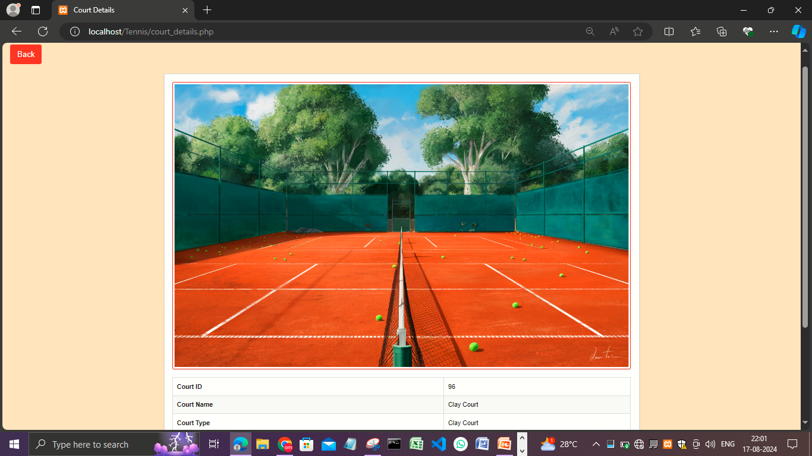
Court Booking
1
Select Court
Choose from available tennis courts based on surface type and location.
2
Pick Date & Time
Find an open timeslot that fits your schedule.
3
Confirm Booking
Secure your reservation and receive a confirmation email.

Slide 8
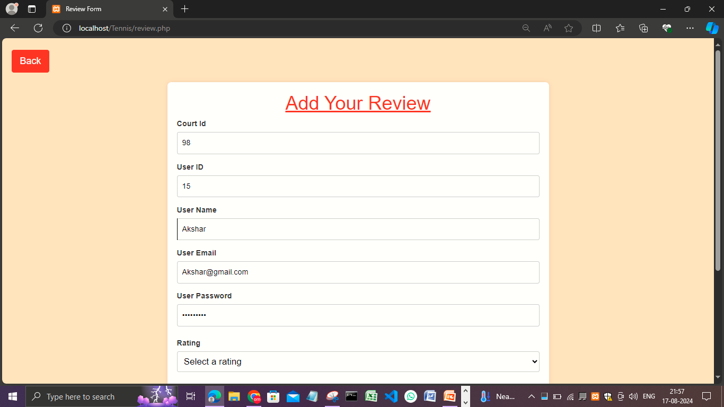
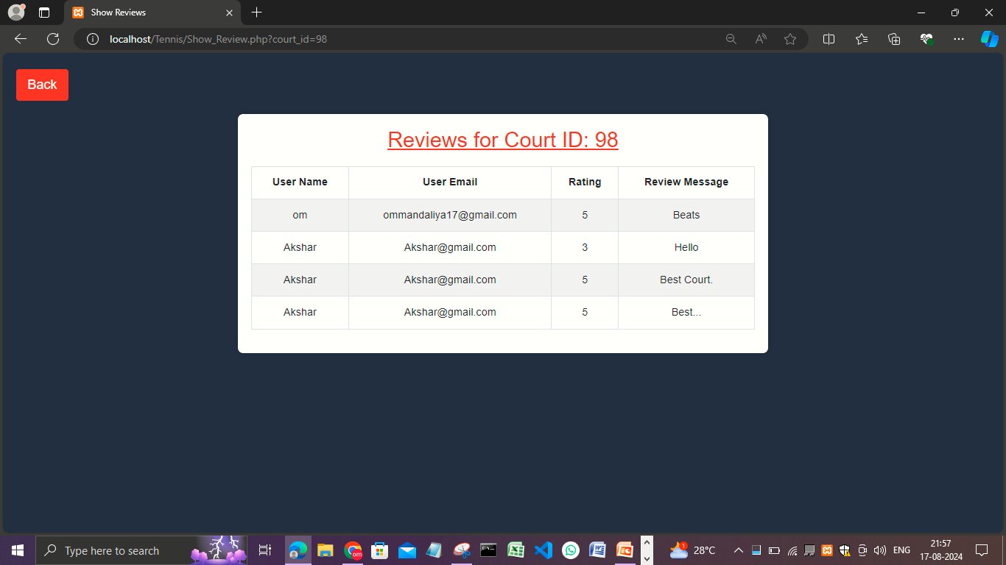
Court Reviews
Ratings
Players can rate courts based on quality, amenities, and overall experience.
Reviews
Read detailed feedback from other users to make informed decisions.
Helpful Insights
Use reviews to choose the best courts for your needs.

Slide 9
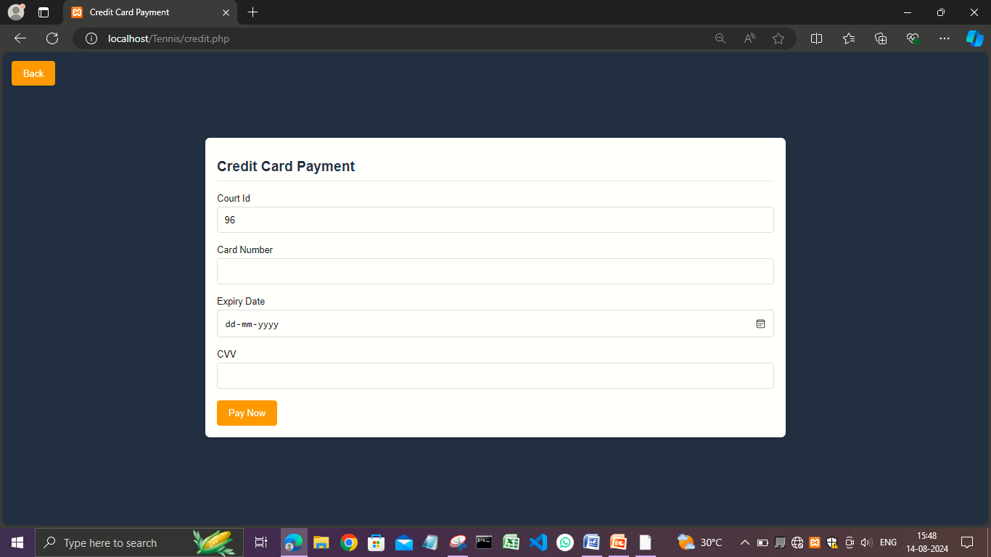
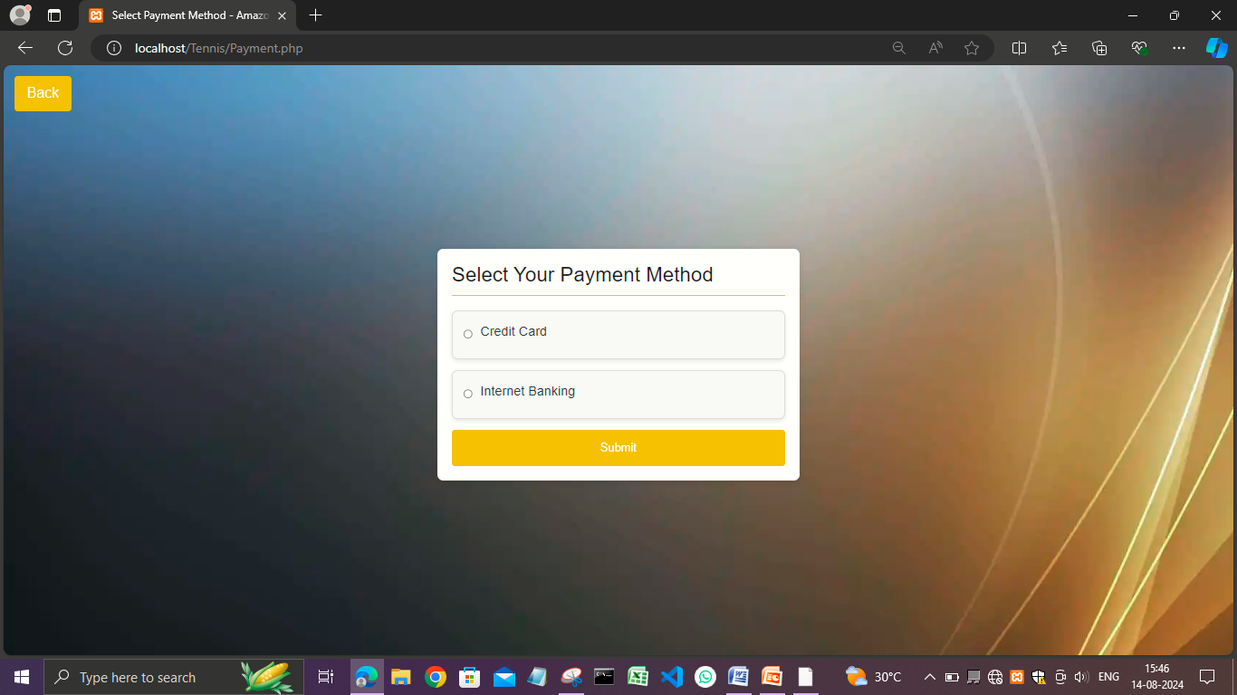
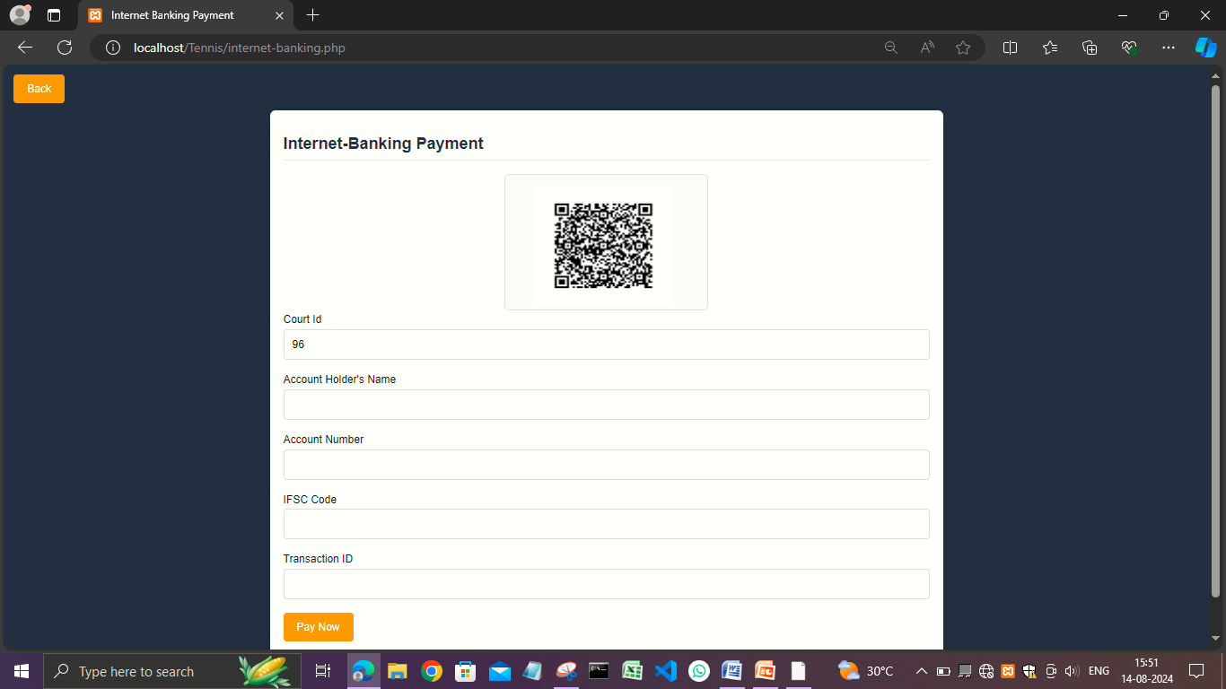
Payment Options
Credit Card Payment
Internet-Banking Payment

Slide 10
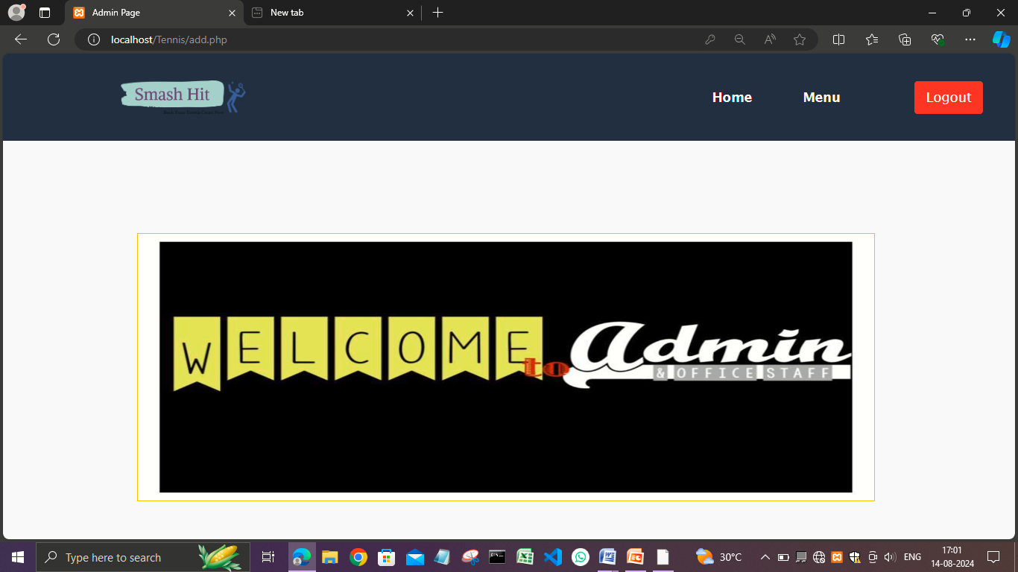
Admin Panel

Slide 11
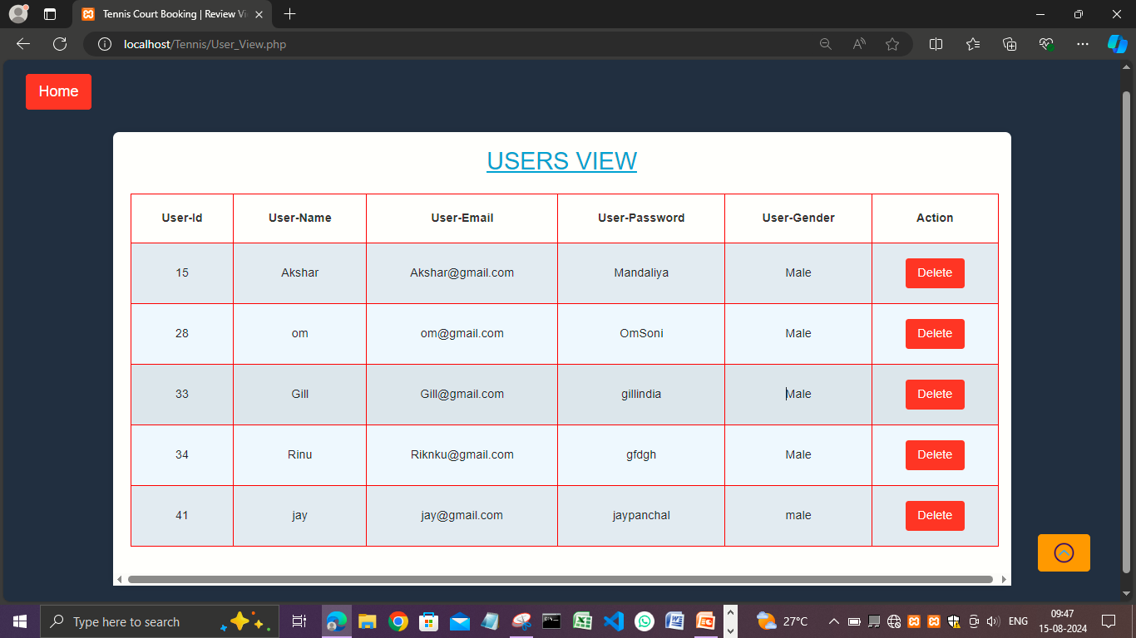
User‘s View
View and manage all registered users.
Edit user details, including username, email, and account status.
Delete or deactivate user accounts as necessary.

Slide 12
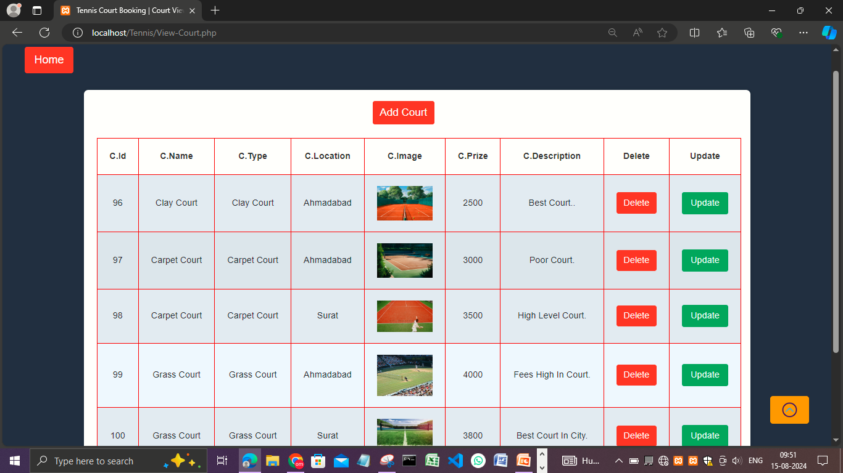
Court‘s View
Display a list of all available tennis courts with their details, including location, type, and availability.
Add new courts to the system or update existing court information.
Delete courts that are no longer available.

Slide 13
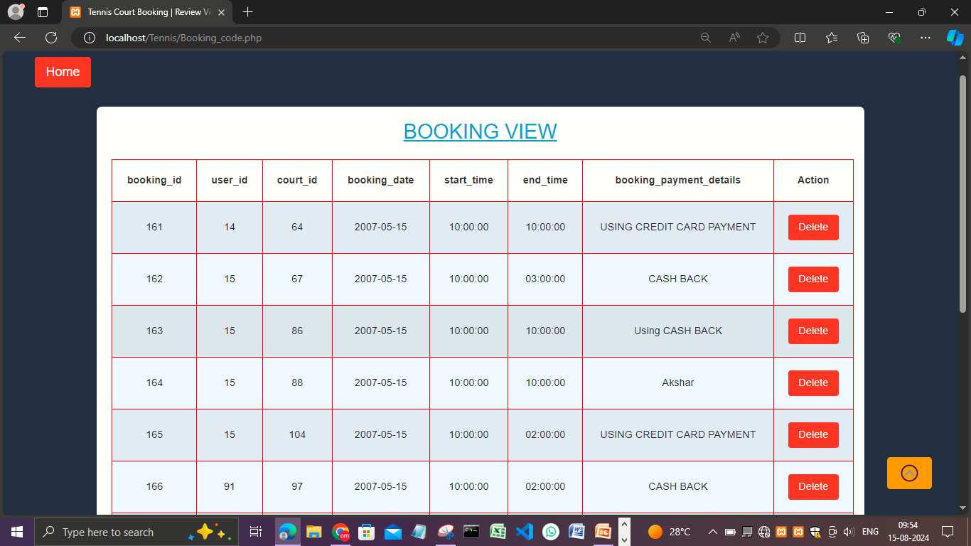
Booking’s View
View all court bookings made by users.
Filter bookings by date, user, or court.
Access detailed booking history for auditing purposes.

Slide 14
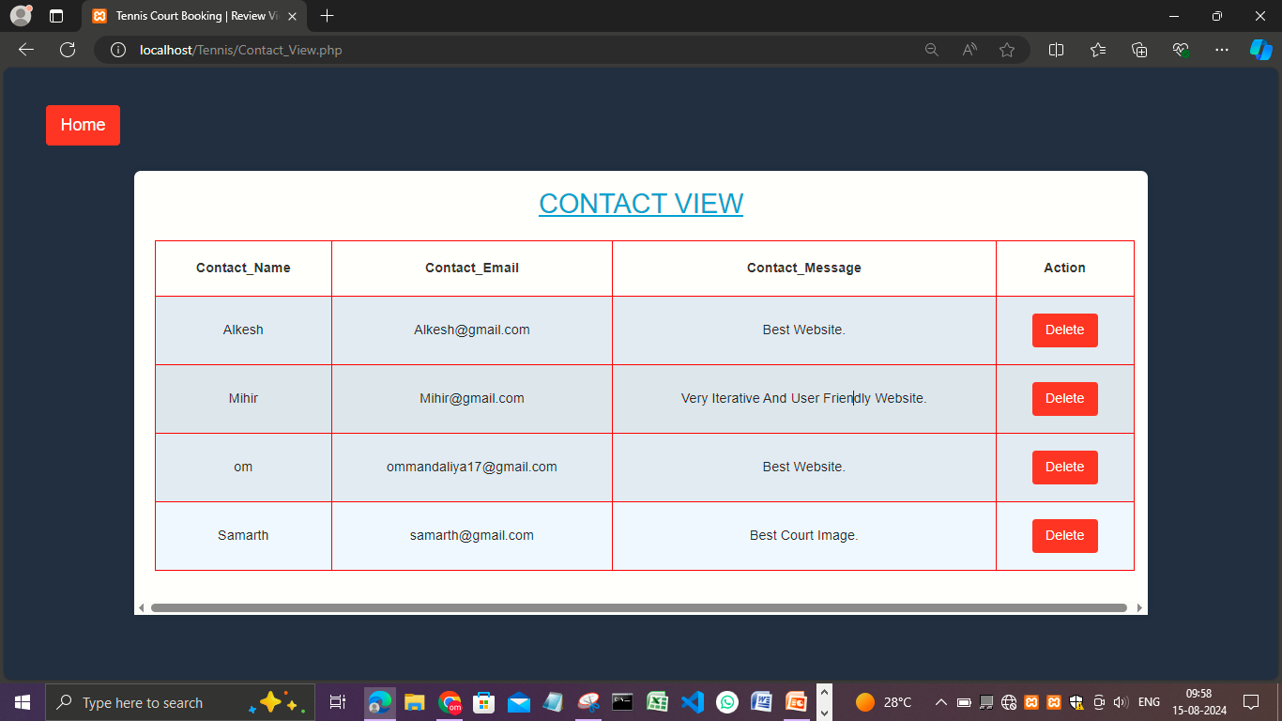
Contact’s View
Access all contact form submissions from users.
Respond to inquiries directly from the admin panel.
View the history of all communication with users.

Slide 15
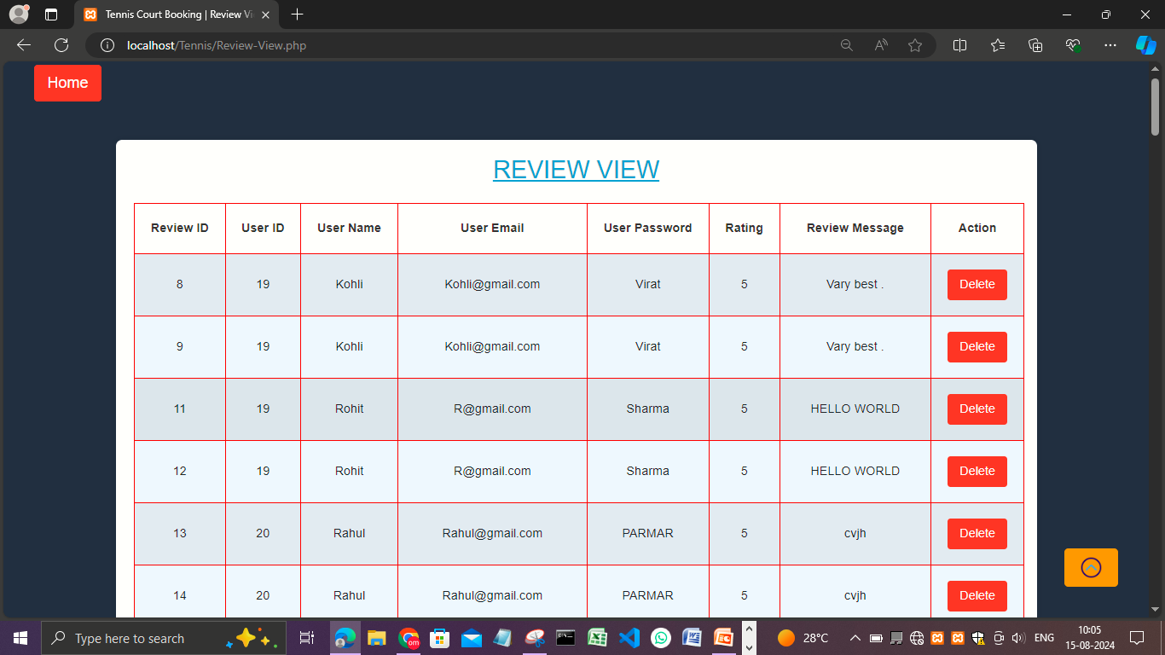
Review’s View
Display all user-submitted reviews for courts.
Approve or reject reviews before they are published.
Edit review content for clarity or to remove inappropriate language.

Slide 16
Conclusion
Thank you for choosing our tennis court booking platform! We strive to provide you with the most convenient and efficient way to book your favorite courts. Our platform offers a seamless experience, allowing you to easily find, book, and manage your tennis sessions at top-rated courts. With a variety of court types, flexible booking options, and detailed reviews, we aim to enhance your playing experience.
Future Work
In the future, we plan to expand our tennis court booking platform by developing a mobile app for easier access, partnering with more facilities to increase court availability, and introducing advanced features like group bookings, AI-powered recommendations, and loyalty programs. We're also exploring the integration of coaching services, virtual training options, and community features to create a more comprehensive and engaging experience for our users.

